Slide 1

Operational Technology Security Protecting Your Critical Infrastructure
Rupesh Shirke
CISSP
LTIMINDTREE
April 11th, 2024
https://www.linkedin.com/in/rupeshshirke

Slide 2

AGENDA
Introduction to Operational Technology
Difference between IT and OT
Importance of OT security - Consequences
OT security landscape
Building OT security strategy
OT security related standards
Certifications
Q&A

Slide 3

Introduction to Operational technology (OT)

Slide 4

What is operational technology(OT)
Operational Technology (OT) is hardware and software that detects or causes a change through the direct monitoring and/or control of physical devices such as valves, pumps, temperature sensors, gas sensors, etc. within industrial processes.
Operational Technology include: Programmable logic controllers (PLCs) Supervisory control and data acquisition systems (SCADA) Distributed control systems (DCS) Remote Terminal Unit (RTU)

Slide 5
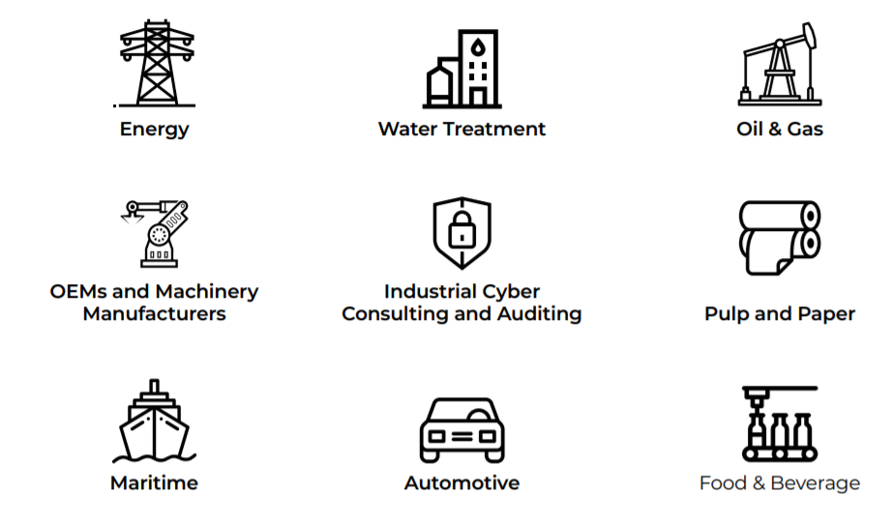
Industries using ot

Slide 6
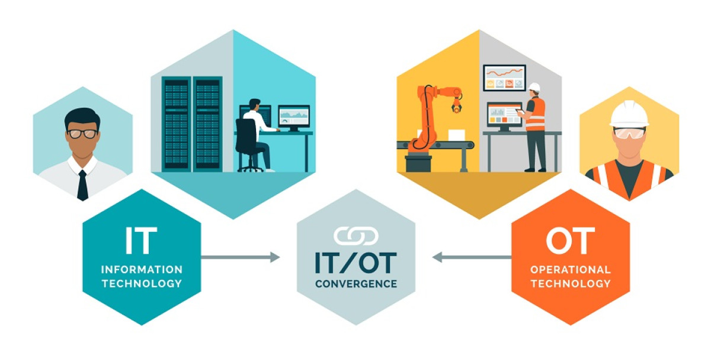
IT Vs ot

Slide 7
IT vs ot
IT
Highly connected using Internet
GenNext technologies used
Primary purpose is to manage and process data
More focus on availability
Operations, device management, network maintenance, testing, technical support and others
OT
Never intended to be connected via Internet
Legacy hardware and technology in use
Primary focus on maintaining functionality
More focus on Safety and reliability
Highly specialized industries such as energy, manufacturing, oi and gas, robotics and more

Slide 8

Why OT Security is Important?
Disruption of critical infrastructure
Financial losses
Environmental damage
Physical harm
Reputational damage
Data theft Real-world OT security Incidents
Colonial Pipeline Attack (2021): Ransomware attack on gas pipeline
Oldsmar Water Treatment Plant Attack (2021)- Hackers remotely accessed a water treatment plant

Slide 9
Ot security landscape

Slide 10
OT security landscape
Threats:
Convergence of IT and OT
Rise of IoT
Sophisticated Attacks – Nation states
Supply Chain Attacks
Consequences of Breaches:
Disruption of Critical Infrastructure
Financial Losses
Safety Risks
Reputational Damage
Trends:
Focus on Proactive Security : layered security strategies that include segmentation, monitoring, and threat intelligence.
Regulations and Standards
Importance of Visibility
Workforce Training
Overall, the OT security landscape demands a comprehensive and constantly evolving approach. By understanding the threats, potential consequences, and emerging trends, organizations can build robust defenses to safeguard their critical infrastructure.

Slide 11
Ot security strategy

Slide 12
OT security strategy
Assess Your Environment: Inventory, Network Mapping, Vulnerability Assessment
Prioritize Risks: Identify Critical Systems, Evaluate Threats, Develop a Risk Register
Implement Security Measures : Network Segmentation, Access Controls, Patch Management, System Hardening, Monitoring and Detection
Develop an Incident Response Plan : Define Roles and Responsibilities, Detection and Analysis, Containment and Eradication, Recovery
People and Processes: Security Awareness Training, Supply Chain Risk Management, Regular Reviews and Audits
Additional Considerations : Compliance, Security Culture
Building an OT security strategy is an ongoing process. By continuously monitoring your environment, adapting to new threats, and refining your approach, you can significantly improve your organization's resilience against cyberattacks.

Slide 13
Ot security standards

Slide 14
Ot security standards
NIST SP 800-82r3 (Guide to Operational Technology Security): Developed by the National Institute of Standards and Technology (NIST) in the US, this comprehensive guide provides a roadmap for securing OT systems Rehearse your responses
IEC 62443: This international standard series from the International Electrotechnical Commission (IEC) focuses on security for industrial automation and control systems (IACS). It covers various aspects like system security requirements, network security, and vulnerability assessments.
Choosing the Right Standard:
The most suitable standard for your organization depends on several factors, including:
Industry Sector: Different industries may have specific regulations or recommended standards.
Size and Complexity: Larger and more complex OT systems may require a more comprehensive standard like NIST SP 800-82r3.
Regulatory Requirements: Compliance with certain regulations may necessitate adherence to specific standards.

Slide 15
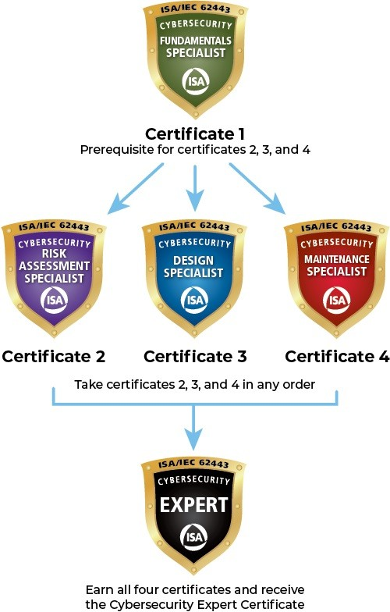

certifications
ISA.org
SANS Institute
While certifications are valuable assets, they should be seen as part of a broader professional development strategy. Continuously learning about new threats, staying updated on the latest security practices, and gaining practical experience are crucial for a successful career in OT security.

Slide 16

This Photo by Unknown Author is licensed under CC BY-SA-NC

Slide 17

THANK YOU
Rupesh Shirke
https://www.linkedin.com/in/rupeshshirke

